Slide 1
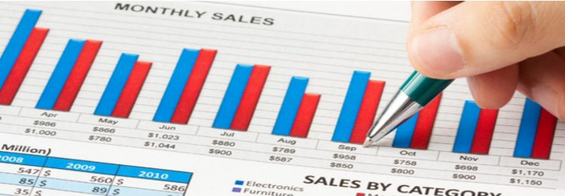

SALE$TER
You’ve got 99 department problems, but sales ain’t one!
Group 1
Diana Gonzalez, Amy Le, Gilat Mandelbaum, Sakina Presswala, Shivani Sethi
Date : 12/18/2017

Slide 2

Python Libraries Used and Data
Pandas - used to create and manipulate data frames for analysis
Numpy - used to aggregate predictor columns for analysis
Matplotlib - used to generate graphs and a .PNG file to save the necessary graph
Sklearn - used for random forest, linear regression, and Naive Bayes classifiers to predict weekly sales
Walmart Data from: http://bit.ly/1IMLANC

Slide 3
Some changes from our Design Doc...
We did not allow user to input year, only store ID and month he/she would like to predict
We did not predict sales for major holidays
We found the predicted top and bottom 10 departments for the month the user will input, not by year
OOP will not be used for this program

Slide 4
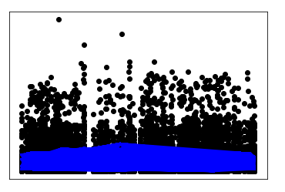
Polynomial Multiple Regression (Predicting Sales)
Predict Weekly Sales based on Temperature, Fuel Price, CPI, Unemployment and isHoliday
Data split into training and test sets randomly
Independent variables normalized/scaled
Polynomial Regression of order 6 gave highest R^2 value
R^2 value still not high enough to be statistically significant
Regression Model not best fit for problem case of predicting sales
According to Literature Review, Neural Network will be a better fit for data set - can attempt later in future
As seen from graph, there is no regression relationship between data points
Polynomial Regression of Order 6
For Test Data - Mean Squared Error: 670682434.376
For Test Data - R^2: 0.12 - Not Statistically Significant

Slide 5
Categories for Decision Tree and Random Forest
Since Decision Trees and Random Forests do not work with floats, we created ranges of values to make categories for the numerical variables.
Weekly_Sales -> sales_class: weekly_sale <=0 negative, 0 < weekly_sale < =25,000 low, 25,000<weekly_sale <100,000 medium, weekly sale =>100000 high
Temperature -> temp_class: t0<=50 cold, 51<to<80 comfortable, to>=80 hot
Fuel Price -> fuel_class: price<=2.8 low, 2.8<price<3.5 medium, price>=3.5 high
Unemployment -> unemploy_class: rate <=5 low, 5<rate<7 medium, rate>=7 high
CPI -> cpi_class: rate < 160 low, 160<=rate<=200 medium, rate>=200 high
Store size -> size_class : size<=100,000 small, 100,000<size<200,000 medium, size>=200,000 large

Slide 6
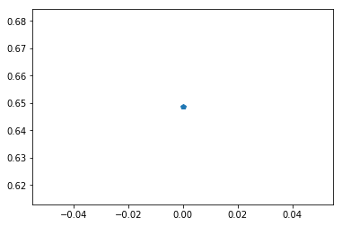
Naive Bayes classifier using Python
Predictor variables: ’Store', 'IsHoliday', 'Dept', 'Type', 'Temp_class', 'Fuel_class', 'Unemploy_class', 'Cpi_class', and 'Size_class'
One-Hot encoder is used to encode the data into binary format.
Split the data into training and test set with ‘sklearn’s train_test_split()’
A Gaussian Naive Bayes classifier is made using training data and is used to make predictions on the test data.
Let’s compare the model’s prediction with actual target values for the test set.
“accuracy_score(target_test, target_pred, normalize = True)”
=>>This model is giving an accuracy of 65%.

Slide 7
Random Forest: To Predict Top and Bottom Departments
Predictor variables: Dept, temp_class, fuel_class, umemploy_class, cpi_class, size_class, Type, and sales_class
Gave numerical values (1,2,3,...) for each predictor because Random Forest method can not string values.
Split data into test and train data using train_test_split from sklearn library
Use RandomForestClassifier to fit train data to predict test response values, which is predicted sales_class.
Accuracy score: 0.9605 and Average Cross Validation Score: 0.68 +/- 0.21
Predictor variable importance score showed Departments having the highest score of 0.81 and size_class the second highest as 0.15, third highest is cpi_class with 0.011.
Per accuracy score, this Random Tree model is good to use to predict sales_class. The predictor variable with most contribution to the model is Department value.
**Since the accuracy score of the Random Tree model is higher than Naive Bayes, we will use Random Tree in our program.

Slide 8
SQL Queries
We put together all the three .csv files (train.csv, features.csv and stores.csv). All the ‘NA’ values in the table features.csv was changed to NULL. The ‘TRUE’ and ‘FALSE’ values for the ISHOLIDAY attribute were changed to binary values 1 and 0 respectively. For analytical purposes and visualization, the variables TEMPERATURE, CPI, UNEMPLOYMENT, FUEL_PRICE and WEEKLY_SALES were all categorized into ‘Low’, ‘Medium’ and ‘High’.
SQL queries as below:=
CREATE TABLE Store_Features
AS
SELECT *
FROM Stores JOIN Features USING(Store);
CREATE TABLE Walmart_Train
AS
SELECT *
FROM Train JOIN Store_Features USING(Store, Week, IsHoliday);
ALTER TABLE walmart_train ADD sales_class varchar(100); UPDATE WALMART_TRAIN SET sales_class = (CASE WHEN Weekly_Sales <= 0 THEN 'Negative' WHEN Weekly_Sales > 0 AND Weekly_Sales <= 25000 THEN 'Low' WHEN Weekly_Sales > 25000 and Weekly_Sales <= 100000 THEN 'Medium' WHEN Weekly_Sales > 100000 then 'High' ELSE NULL END); ALTER TABLE walmart_train ADD temp_class varchar(100); UPDATE WALMART_TRAIN SET temp_class = (CASE WHEN Temperature <= 50 THEN 'Cold' WHEN Temperature > 50 AND Temperature < 80 THEN 'Comfortable' WHEN Temperature >= 80 then 'Hot' ELSE NULL END);
ALTER TABLE walmart_train ADD fuel_class varchar(100); UPDATE WALMART_TRAIN SET fuel_class = (CASE WHEN Fuel_Price <= 2.8 THEN 'low' WHEN Fuel_Price > 2.8 AND Fuel_Price < 3.5 THEN 'Medium’ WHEN Fuel_Price >= 3.5 then 'High' ELSE NULL END); ALTER TABLE walmart_train ADD unemploy_class varchar(100); UPDATE WALMART_TRAIN SET unemploy_class = (CASE WHEN Unemployment <= 5 THEN 'low' WHEN Unemployment > 5 AND Unemployment < 7 THEN 'Medium' WHEN Unemployment >= 7 then 'High' ELSE NULL END); ALTER TABLE walmart_train ADD cpi_class varchar(100); UPDATE WALMART_TRAIN SET cpi_class = (CASE WHEN CPI <= 160 THEN 'low' WHEN CPI > 160 AND CPI < 200 THEN 'Medium' WHEN CPI >= 200 then 'High' ELSE NULL END); ALTER TABLE walmart_train ADD size_class varchar(100); UPDATE WALMART_TRAIN SET size_class = (CASE WHEN Size <= 100000 THEN 'low' WHEN Size > 100000 AND Size < 200000 THEN 'Medium' WHEN Size >= 200000 then 'High' ELSE NULL END);

Slide 9
It’s time to test out our models for SALE$TER!
Can we help out DAGSS, the Walmart Store 1 Manager??

Slide 10

Hi, I’m DAGSS, Walmart’s Store 1 Manager
(short for Diana, Amy, Gilat , Shivani, Sakina, and I like daggers…) I am a very busy woman and I don’t have time to figure out my store’s weekly sales and find which of my hundred departments have the best and worse sales. I want to know how much money will the store to make each week for July and which departments will contribute the most to that month. I heard SALE$TER was a good program to use for this very particular need.

Slide 11
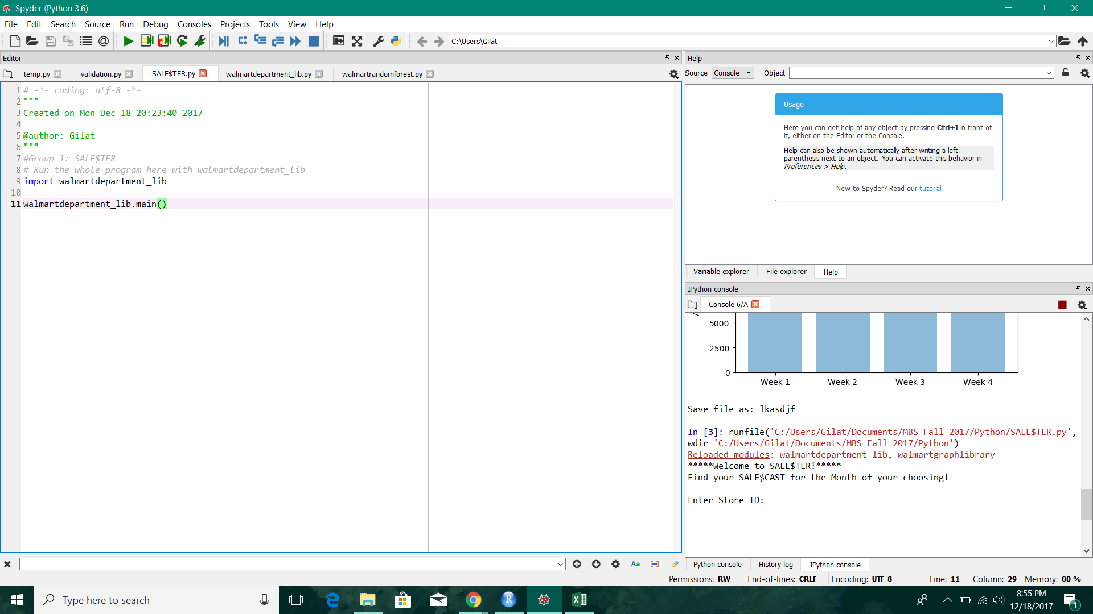
SALE$TER IN ACTION!
I will use SALE$TER to find my store’s SALE$CAST. I entered my Store ID (1) and July(7) for the month I want to predict.

Slide 12
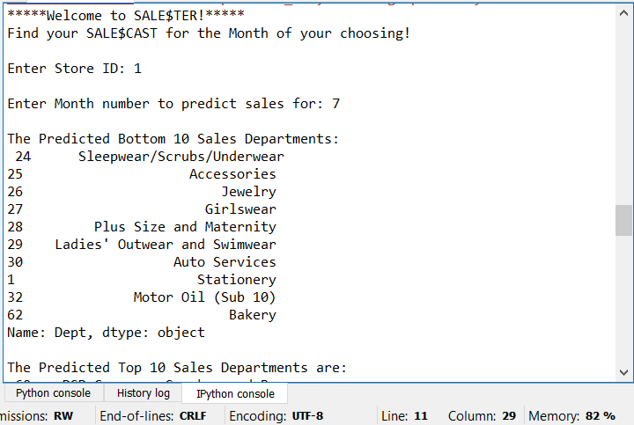
Here I entered my Store ID (1) and the month I want to predict, July (7)
Here I see which departments I will need to keep a close eye on to make sure my store runs smoothly. I will increase sales in women’s clothing and I won’t need to buy extra stuff for auto services and stationary. I can allow Bakery staff to take more vacation days since it seems like that department won’t be busy.

Slide 13
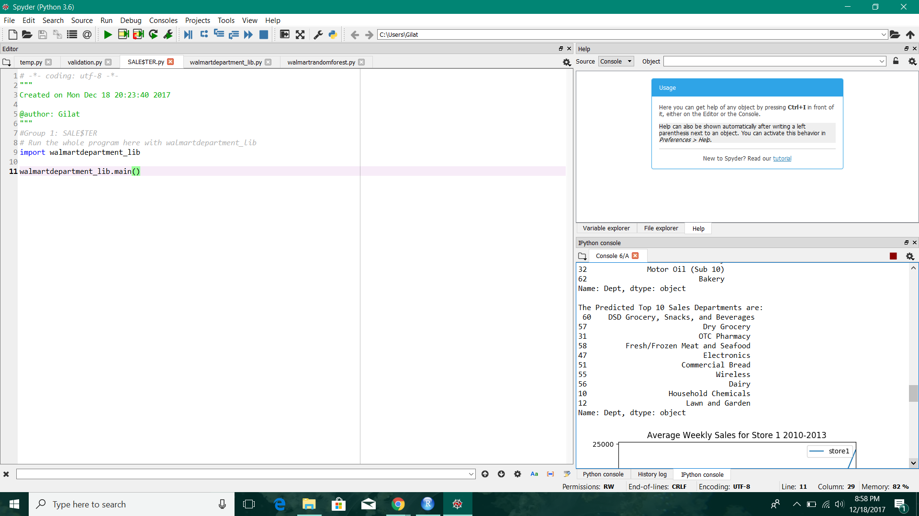
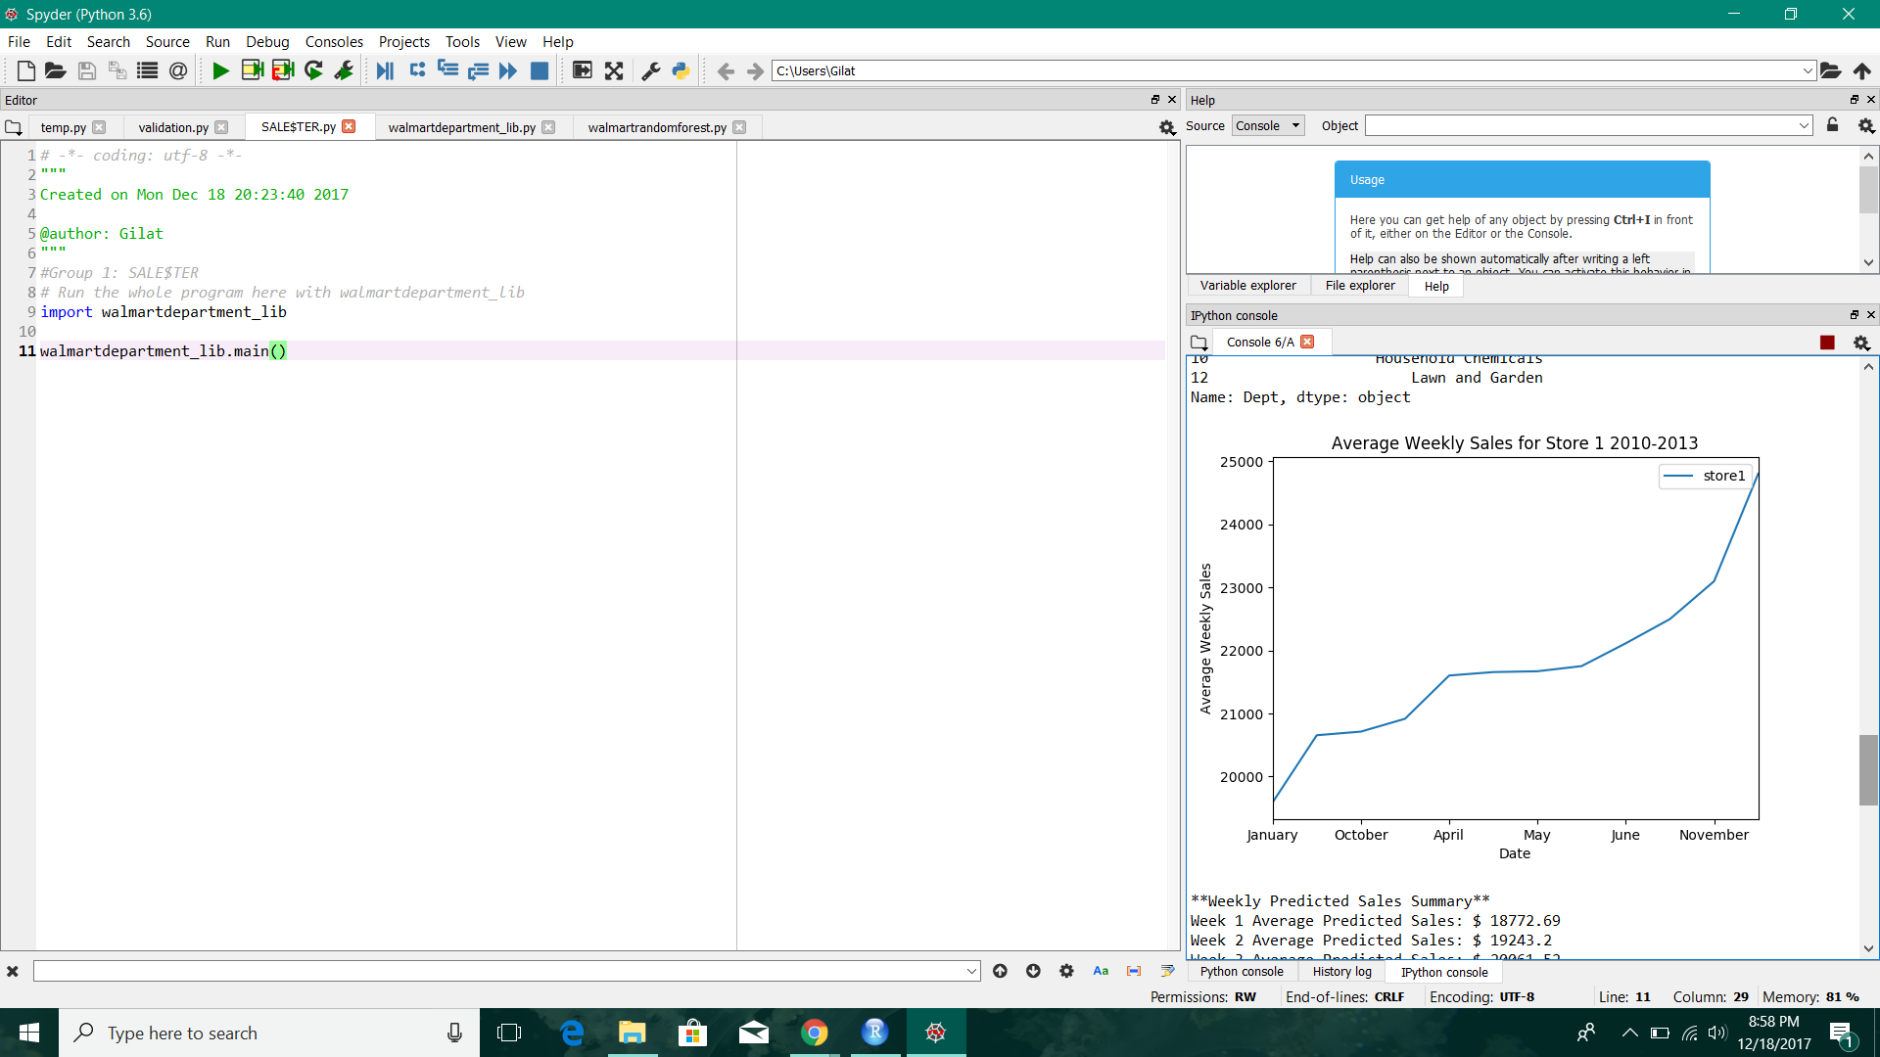
These are the top 10 departments, which I will most likely add additional help to make sure these departments run smoothly during their busy times
This is the graph with my store’s average weekly sales from 2010-2013 - this is helpful to see the trends throughout the years.

Slide 14
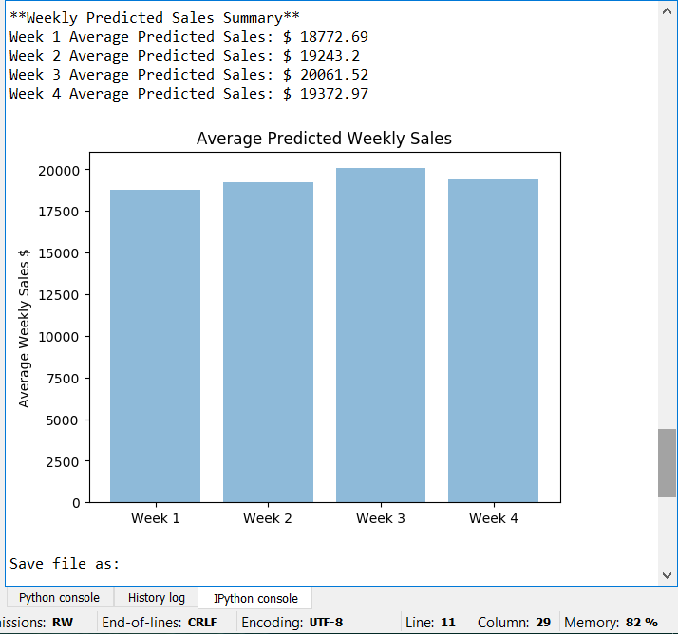
Here I see the Weekly Predicted Sales for the month of July. I also get a nifty bar graph to give me a visual of the numbers predicted.
Even cooler! I can save my graph into a file and name it whatever I want!!

Slide 15
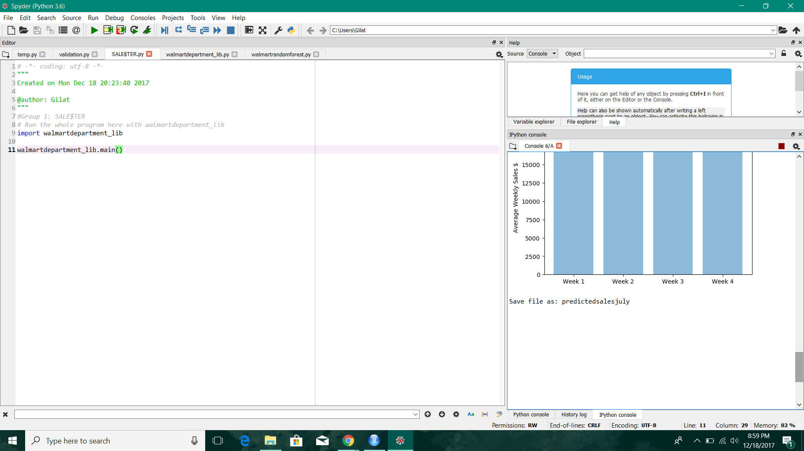
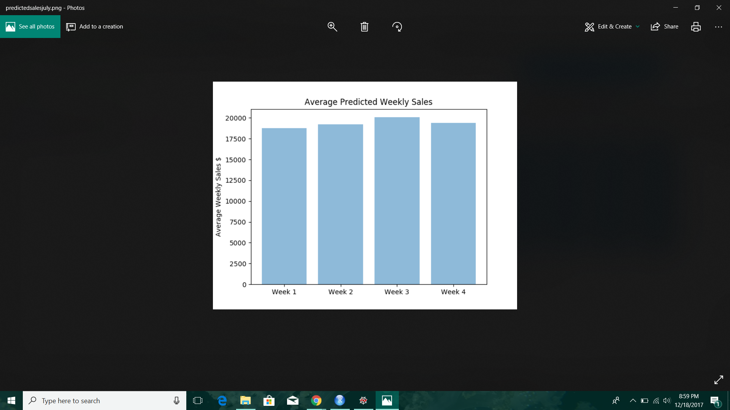
I decided to name my file predictedsalesjuly.png (the file will be in .PNG).
PING!

Slide 16

SALE$TER IS AWESOME!
WOW, SALE$TER saved me! Now I have time to sharpen my daggers! I mean, do some laundry…

